Slide 1

AMR Pipeline and Sample Report
Rapid Response – Updated July 2024
Notes:
Slides updated 07/02/2024

Slide 2
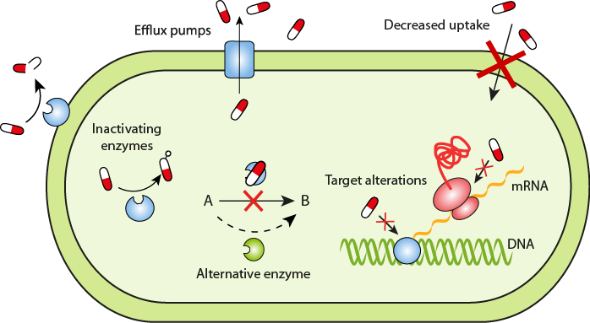
Antimicrobial Resistance (AMR) Mechanisms
Stop antibiotic from reaching target
Modify or bypass the antibiotic target
ReAct: Resistance Mechanisms

Slide 3
Antimicrobial Resistance (AMR) Mechanisms
Stop antibiotic from reaching target
  Pump the antibiotic out of the cell (efflux pumps)
  Decrease uptake (membrane permeability)
  Destroy or modify the antibiotic (inactivating enzymes)
ReAct: Resistance Mechanisms

Slide 4
Antimicrobial Resistance (AMR) Mechanisms
Stop antibiotic from reaching target
  Pump the antibiotic out of the cell (efflux pumps)
  Decrease uptake (membrane permeability)
  Destroy or modify the antibiotic (inactivating enzymes)
Modify or bypass the antibiotic target
  Camouflage or reprogram the target
(target alteration)
  Use a different protein
(expression of alternative proteins)
ReAct: Resistance Mechanisms

Slide 5
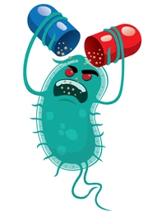

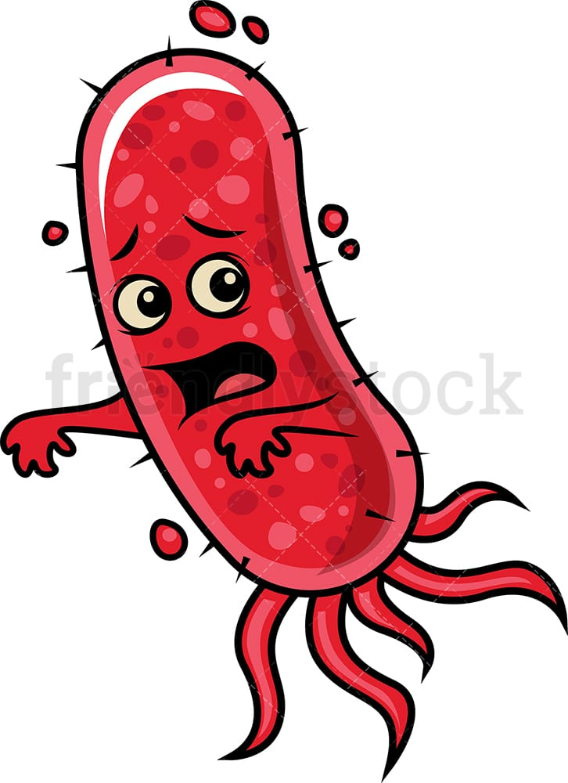

What can give rise to AMR?
Intrinsic resistance (e.g., Gram positive vs Gram negative)
Acquisition of new genetic material
(Horizontal gene transfer)
Mutation

Slide 6
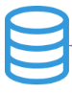
mNGS vs AMR Detection Pipelines
Pipeline
Input
Database
Main goal
mNGS
Metagenomic data (reads/contigs)
Known reference genomes (complete or partial) and translated sequences
Taxonomic identification

Slide 7
mNGS vs AMR Detection Pipelines
Pipeline
Input
Database
Main goal
mNGS
Metagenomic data (reads/contigs)
Known reference genomes (complete or partial) and translated sequences
Taxonomic identification
AMR
Metagenomic or whole genome sequence data
(reads/contigs)
Known reference AMR genes and translated sequences
AMR gene detection

Slide 8
CZ ID’s AMR Pipeline Highlights
Supports whole genome sequence (WGS) and metagenomic data.
Uses the Comprehensive Antibiotic Resistance Database (CARD).
  Combines the Antibiotic Resistance Ontology (ARO) with curated AMR gene sequences and resistance-conferring mutations.
Uses both sequence reads and assembled sequences (contigs) for AMR gene detection.
Performs pathogen-of-origin prediction by matching query sequences to known pathogen sequences found in CARD (beta).

Slide 9
AMR Database
CARD includes two database modules:
1. Canonical CARD: Includes curated and functionally characterized AMR genes from the literature
2. Resistomes and Variants (aka. WildCARD): Supplemental database of computationally predicted AMR genes and variants and their Prevalence.
Expands CARD, which is strongly biased towards common clinical pathogens
Only used for pathogen-of-origin prediction
Notes:
Discuss differences - what might you find in WildCARD vs Canonical?

Slide 10
AMR Pipeline Workflow CZ ID
Upload
Raw NGS sequences
(mNGS and WGS)
CARD DB and RGI
https://card.mcmaster.ca/
Notes:
Species identification using CARD and WildCard modules (resistomes, variants & prevalence db)

Slide 11
AMR Pipeline Workflow CZ ID
Upload
Data Pre-processing
Raw NGS sequences
(mNGS and WGS)
Quality/Host Filtering + Deduplication + Subsampling (same as mNGS)
*
post-QC .fq file
*
Assembly
contig.fa
*Duplicate reads are added back before contig assembly and AMR gene detection
CARD DB and RGI
https://card.mcmaster.ca/
Notes:
Species identification using CARD and WildCard modules (resistomes, variants & prevalence db)

Slide 12
AMR Pipeline Workflow CZ ID
Upload
Data Pre-processing
AMR Gene Detection +
Pathogen-of-origin Identification
Resistance Gene Identifier (RGI)
Quality + Host Filtering + Subsampling (same as mNGS)
Raw NGS sequences
(mNGS and WGS)
Quality/Host Filtering + Deduplication + Subsampling (same as mNGS)
*
post-QC .fq file
Read k-mer alignment (KMA) against CARD + species identification (WildCARD)
*
Assembly
contig.fa
Contig homology searches (BLAST) against CARD + species identification (WildCARD)
*Duplicate reads are added back before contig assembly and AMR gene detection
CARD DB and RGI
https://card.mcmaster.ca/
Notes:
Species identification using CARD and WildCard modules (resistomes, variants & prevalence db)

Slide 13
AMR Pipeline Workflow CZ ID
Upload
Data Pre-processing
AMR Gene Detection +
Pathogen-of-origin Identification
Report
Resistance Gene Identifier (RGI)
Raw NGS sequences
(mNGS and WGS)
Quality/Host Filtering + Deduplication + Subsampling (same as mNGS)
*
post-QC .fq file
Read k-mer alignment (KMA) against CARD + species identification (WildCARD)
Merge results
AMR Sample Report
*
Assembly
contig.fa
Contig homology searches (BLAST) against CARD + species identification (WildCARD)
*Duplicate reads are added back before contig assembly and AMR gene detection
CARD DB and RGI
https://card.mcmaster.ca/
Notes:
Species identification using CARD and WildCard modules (resistomes, variants & prevalence db)

Slide 14
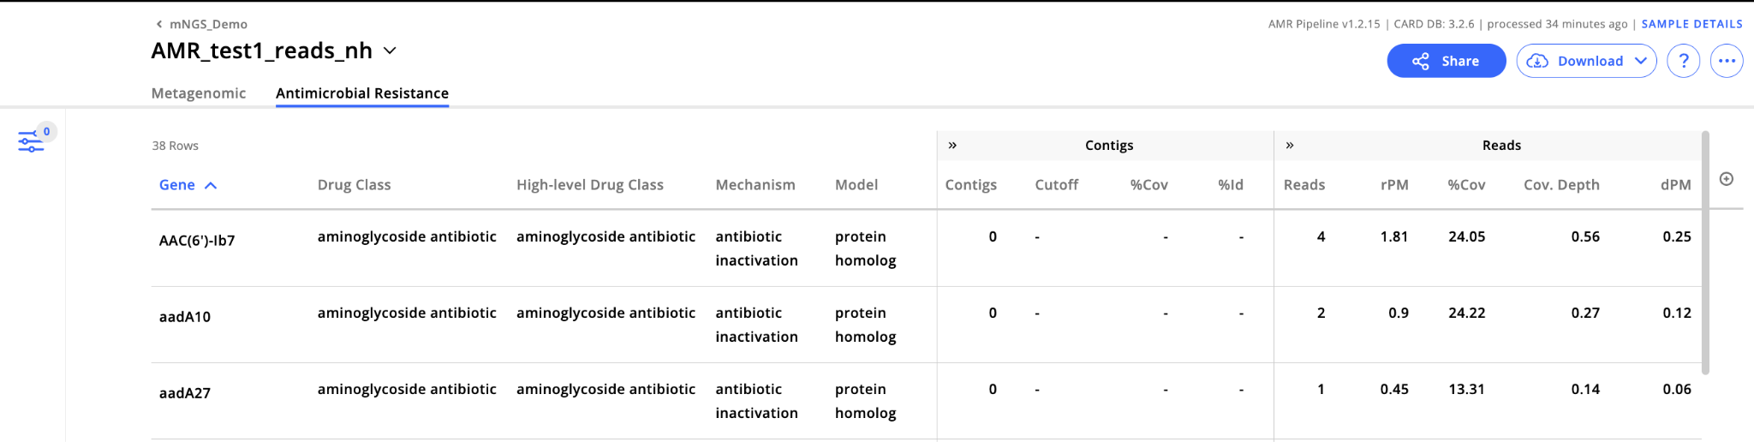
AMR Sample Report

Slide 15
AMR Sample Report: Gene Information
Gene: Gene name for best match in CARD
Gene Family: Refers to the ARO category for gene family
Drug Class: Refers to the ARO category specifying resistance to a given antibiotic molecule, including antibiotic/adjuvant combination medications.
High-level Drug Class: Refers to the antibiotic family of identified drug class.
Resistance Mechanism: Refers to the ARO category specifying the resistance mechanism for a given AMR gene.
Model: Specifies the model used for AMR detection. Models distinguish underlying molecular categories for detected AMR sequences (e.g., presence of genes vs mutations). More on models on the next slide…
Notes:
Antibiotic families are classified based on mechanism of action, chemical structure, or spectrum of activity.
Model corres[omds to the molecular category of the AMR gene prediction

Slide 16
Models for AMR Gene Detection
Protein Homolog Models (PHM): Detect dedicated AMR genes (“presence/absence”). Example: NDM-1, a metallo-beta-lactamase isolated from Klebsiella pneumoniae with nearly complete resistance to all beta-lactam antibiotics
  Represent ~⅔ of CARD
  Contigs: BLASTP against CARD database (protein:protein alignment).
  Reads: KMA against PHM sequences (only model used for calling reads)

Slide 17
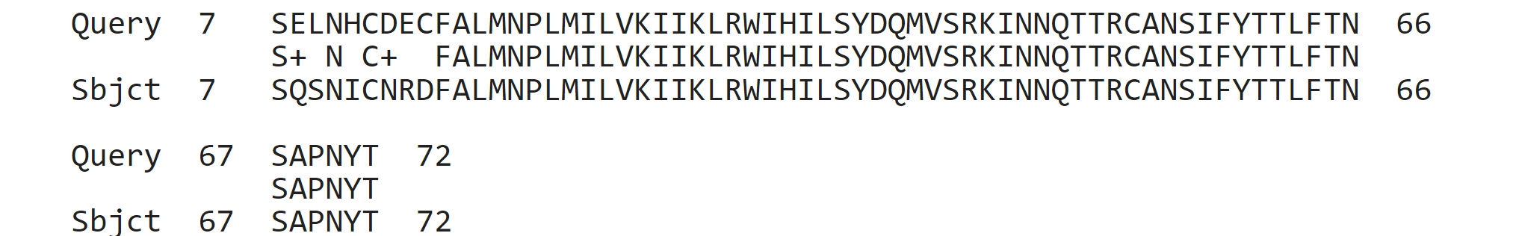
Models for AMR Gene Detection
Protein Homolog Models (PHM): Detect dedicated AMR genes
Protein Variant Models (PVM): Detect AMR acquired via mutation of house-keeping genes or antibiotic targets.
  2nd largest in CARD
  PVMs screen query sequences for curated sets of mutations that could differentiate them from antibiotic susceptible genotypes. Example: gyrA, mutations in the A subunit of DNA gyrase reduce its affinity for fluoroquinolones.

Slide 18
Models for AMR Gene Detection
Protein Homolog Model (PHM)- Detect dedicated AMR genes
Protein Variant Model (PVM) - Designed to detect AMR acquired via mutation of house-keeping genes or antibiotic targets
Protein Overexpression Models (POM) - Detect mutations in regulatory proteins.
  Similar to PVM but restricted to regulatory proteins.
  POM screen for mutations that may lead to overexpression of efflux complexes.
  Example: MexS, a suppressor of MexT, which is an activator of the multidrug pump MexEF-OprN. Mutations in MexS lead to multidrug resistance.

Slide 19
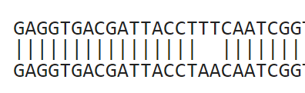
Models for AMR Gene Detection
Protein Homolog Model (PHM)- Detect dedicated AMR genes
Protein Variant Model (PVM) - Detect AMR acquired via mutation of house-keeping genes or antibiotic targets.
Protein Overexpression Model (POM) - Detect mutations in regulatory proteins.
rRNA Gene Variant Models (RVM) - Detect AMR acquired via mutation of genes encoding rRNA (nucleotide:nucleotide alignment).
  Screens query sequences for curated sets of mutations that could differentiate them from antibiotic susceptible genotypes
  Example: Cjej_23S_ERY, point mutations in the 23S ribosomal RNA domain of C. jejuni which confer resistance to macrolide antibiotics, including erythromycin.

Slide 20
AMR Sample Report: Contig Metrics
Contigs: Total number of contigs matching a given AMR gene
Cutoff: Cutoff used to detect AMR-associated contigs based on curated BLAST bit-score thresholds.
  Perfect: Detects perfect or identical matches to the curated reference sequences in CARD
  Strict: Detects previously unknown variants of known AMR genes and includes a secondary screen for key mutations (predicts functional variants)
  Loose: Detects new and more distant homologs of AMR genes by working outside of established BLAST bit-score cut-offs allowing for AMR gene discovery. CZ ID only reports Loose contig matches that have at least 95% identity to known AMR genes (identified as "Nudged")
    Nudged cut off does NOT account for alignment length
(More info here)
Notes:
CZ ID uses canonical CARD database for all of these (Perfect, Strict, Loose)
Loose not used often (leads to spurious hits). Maybe useful if you have a phenotype you can’t explain based on Perfect/Strict matches.
Strict vs Loose is based on the BLASTp score (curated per target)

Slide 21
AMR Sample Report: Contig Metrics (cont.)
Contig Coverage Breath (% Cov): Percentage length of the reference sequence that was covered by contigs
Contig Percent Identity (% ID): Average percent identity between contigs and their top match in CARD
Contig Species: Pathogen-of-origin prediction based on AMR-associated contig sequences.

Slide 22
AMR Sample Report: Read Metrics
Reads: Total number of reads mapping to a given AMR reference sequence.
Read Coverage Breadth (% Cov): Percent length of the reference sequence covered by read sequences.
Read Coverage Depth (Cov. Depth): Mean read depth across the reference sequence.
Read Species: Pathogen-of-origin prediction
based on AMR-associated reads.
depth
AMR gene
breadth

Slide 23
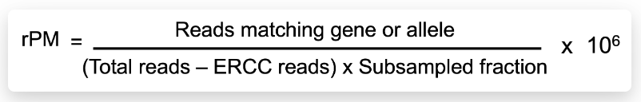
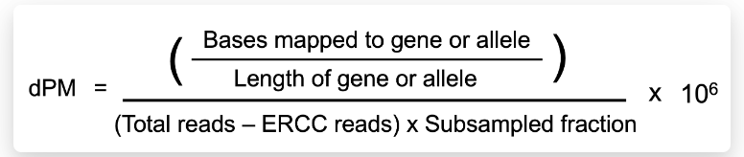
Normalized Read Metrics
When comparing across samples is important to normalize the data to make sure what we see is not just an artifact of one sample having more reads than another.
Reads per million (rPM)
Depth per million (dPM)
https://www.nature.com/articles/s41598-018-24280-8.pdf?origin=ppub

Slide 24
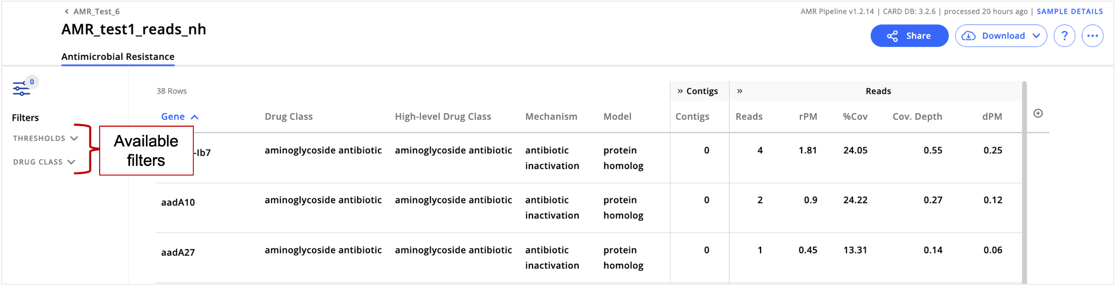
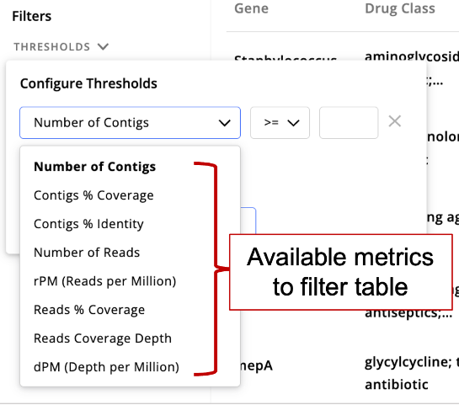
Applying Filters to AMR Sample Report
AMR genes tend to be at low abundances unless they are enriched (e.g., FLASH protocol). Use relaxed parameters compared to filters used for mNGS analysis
Suggested threshold:
  AMR genes with at least 5% (mNGS data) or 50% (WGS data) coverage.
  At least 5 reads matching AMR gene.

Slide 25
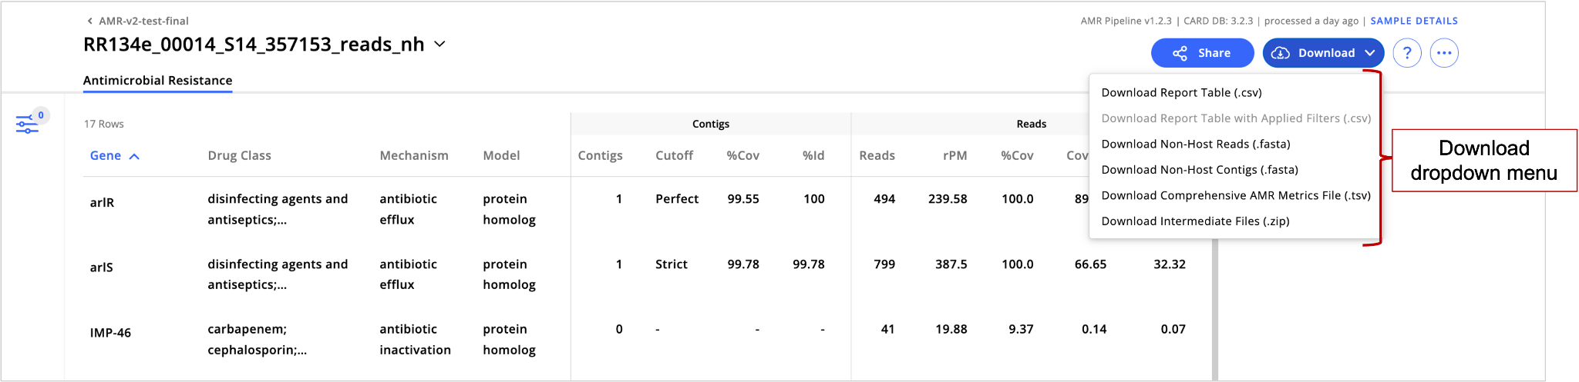
Downloading Data from AMR Sample Report

Slide 26
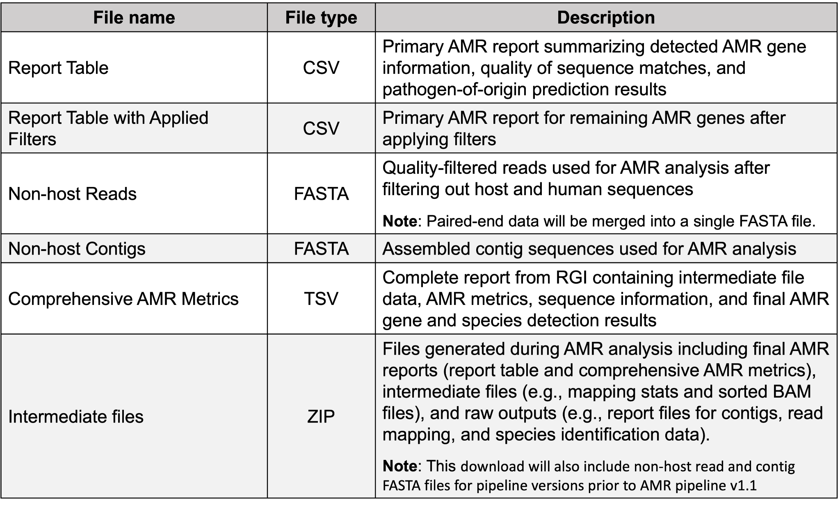
AMR Sample Report Download Options

Slide 27
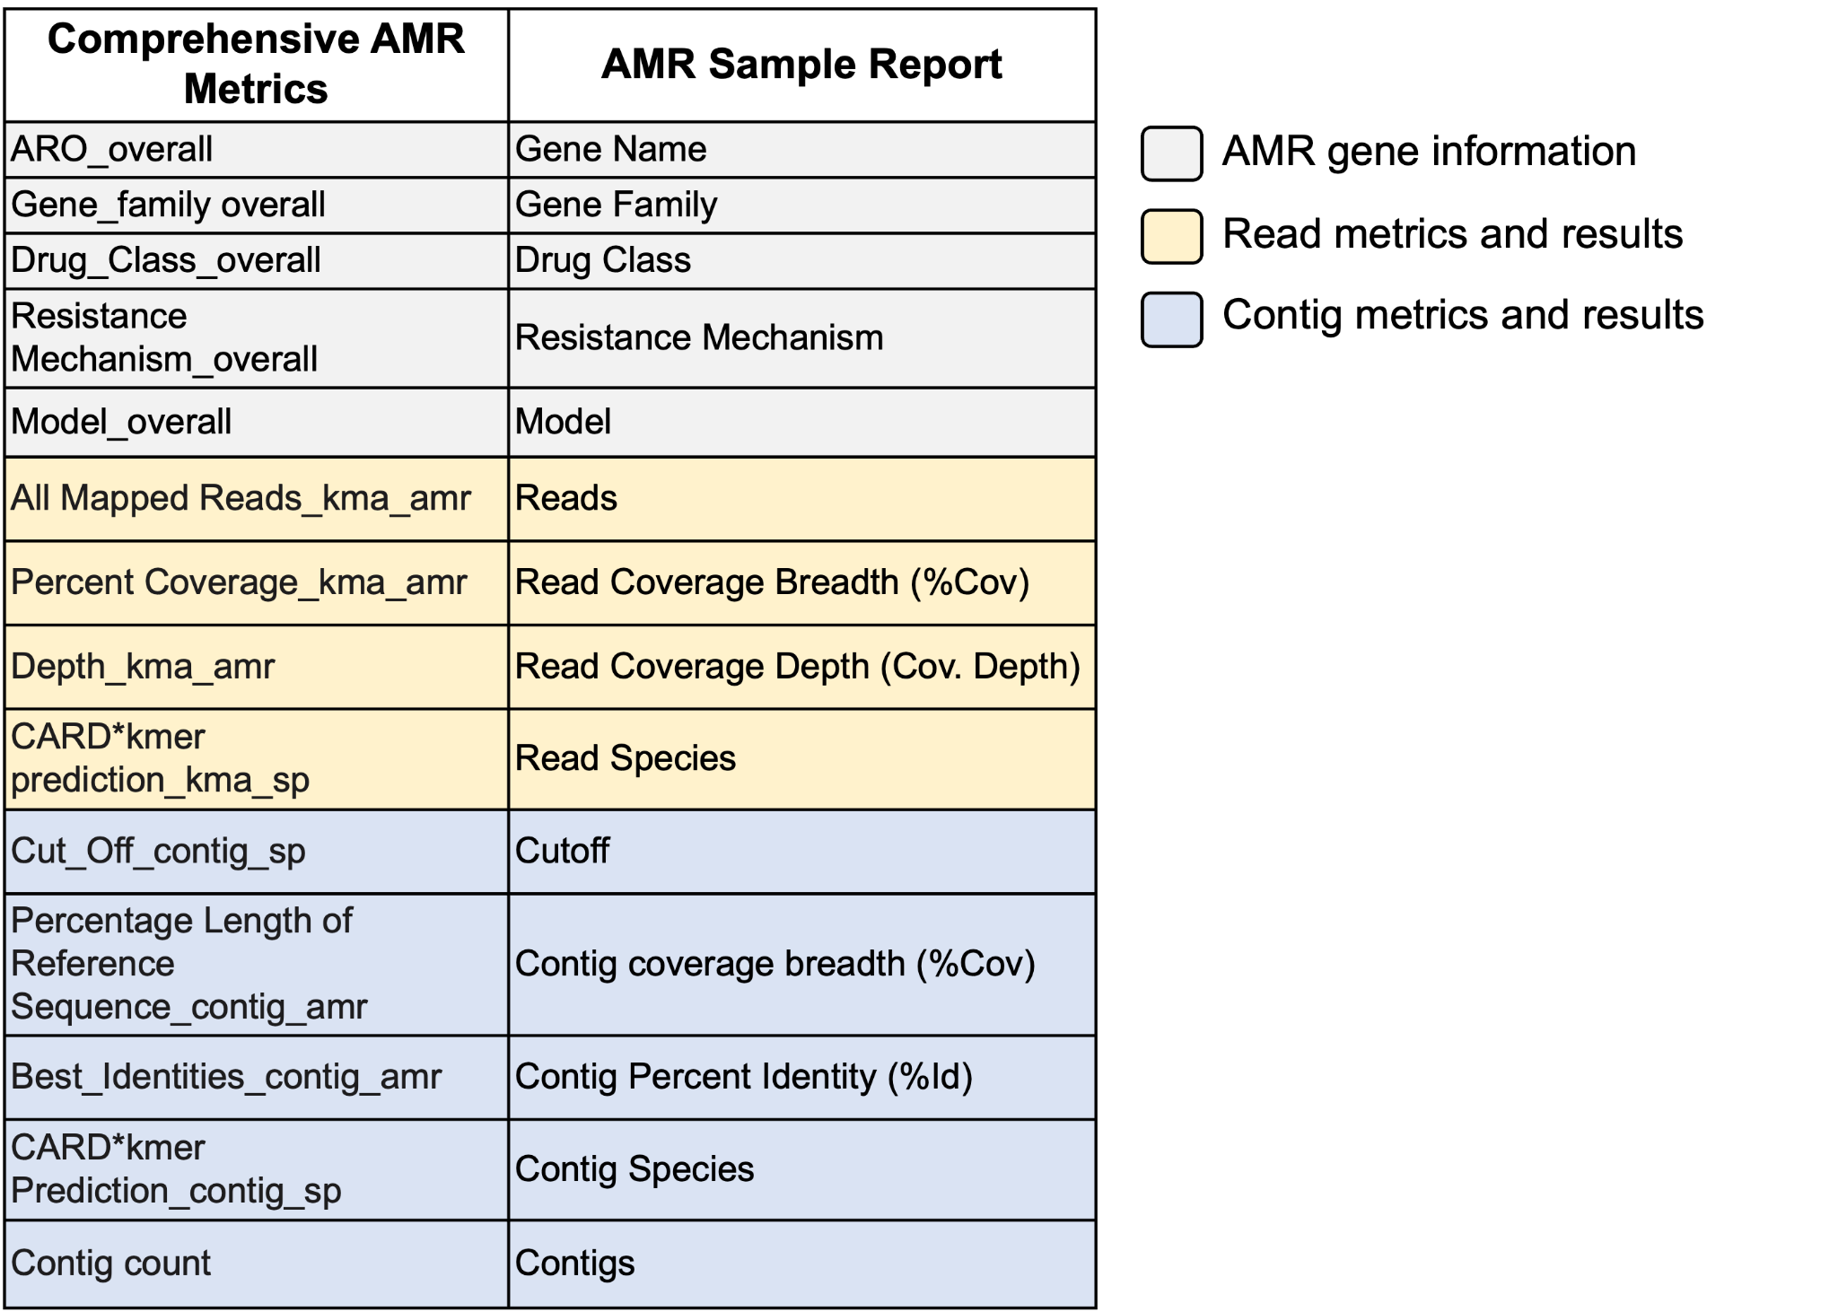
Report Table vs Comprehensive AMR Metrics
Report Table - CZ ID summary from RGI report
Comprehensive AMR Metrics - Report from RGI

Slide 28
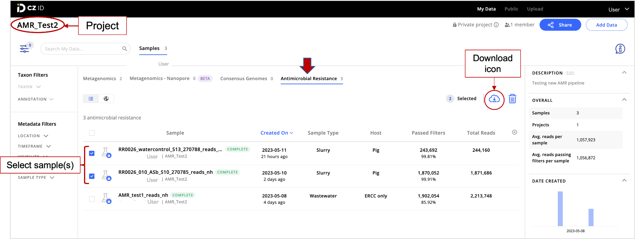
Downloading AMR Data from Project Page

Slide 29
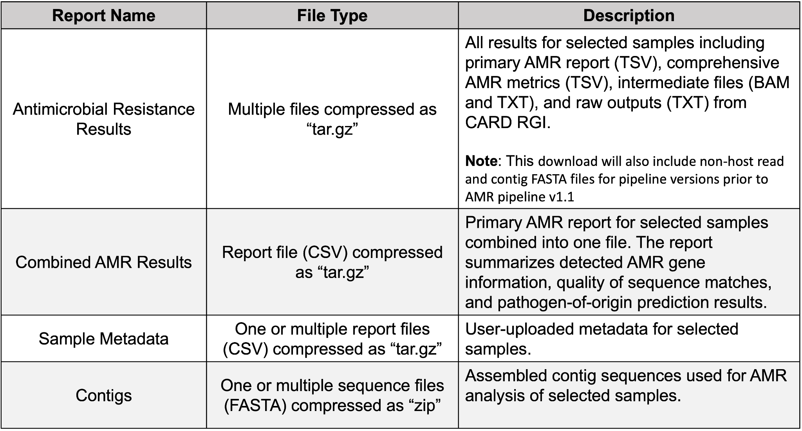
AMR Project Page Download Options

Slide 30
AMR Heatmaps
Currently, CZ ID does not have heatmap functionality for the AMR module.
You can create heatmaps outside CZ ID by running a heatmap generator script that will use the Combined AMR Report from CZ ID as input data.
  The heatmap script can run locally on your machine or on the web via Google Colab.
  Running the script through Google Colab is easy, with no software installations or prior coding experience needed.
  Visit the GitHub page for the AMR Heatmap Generator Script to learn more and get started.

Slide 31
Notes
May be challenging to distinguish sequencing error/artifacts from true SNPs that confer resistance
There may be differences in AMR genes and species detected with contig data versus those identified with read data
  KMA (reads) vs Assembly/BLAST (contigs)
  Read AMR detection based on 1 out of 4 models (PHMs alone), whereas contig AMR detection uses 4 models
CZ ID mNGS & AMR modules may report different species. This is due to differences in databases & alignment methods
Known contaminant:
  TEM-116: This AMR gene is part of the pUC5 plasmid, which is in a number of PCR reagents. It also may exist in clinical samples but definitely known to be in lab reagents (see discussion)

Slide 32
Examples
Tracing microbial contaminant in transfusion patients
Pathogen transmission in hospital setting (neonatal surveillance)
Pathogen dynamics within pneumonia patient (temporal study)
AMR genes in wastewater
Notes:
  mNGS data: coverage breadth >5% and matches based on reads required > 5 reads mapping to AMR genes
  WGS data: coverage breadth >50% and matches based on reads required > 5 reads mapping to AMR genes
  Matches based on PHMs and PVMs alone

Slide 33
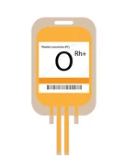

Example 1: Microbial contaminant in transfusion patients (data from Crawford et al 2020)
Two immunocompromised patients (A and B) received platelet unit transfusions from the same donor. Both patients developed septic shock hours after the transfusion.
Patient A treated with cefepime at the time of transfusion
Approach: mNGS (DNA) and methicillin-susceptible S. aureus (MSSA) culturing followed by WGS
A
B
Bag culture
Blood mNGS (pre- and post-transfusion)
Blood culture (post-transfusion)

Slide 34
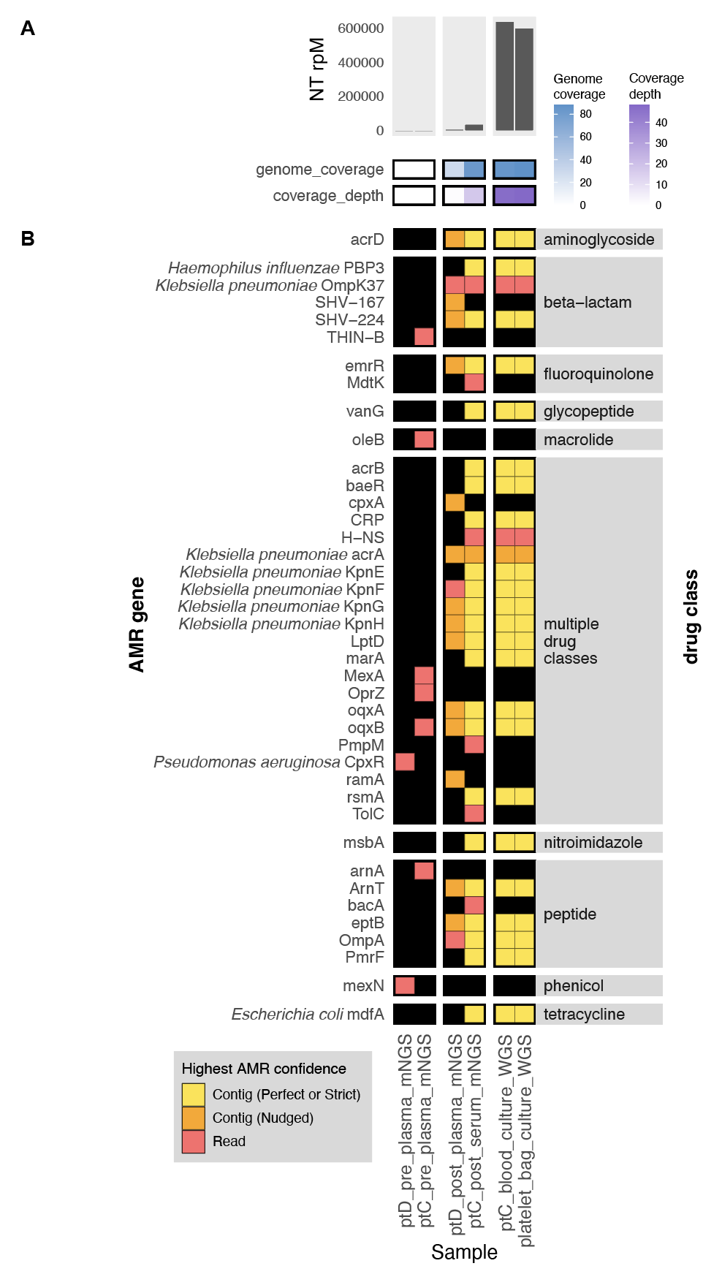
Read mapping results for Klebsiella pneumoniae
mNGS
Pre
Post
WGS
A B
A B
B Bag
Notes:
Patient C ~3000 rpm, Patient D ~200 rpm)

Slide 35
Read mapping results for Klebsiella pneumoniae
Reads mapping to K. pneumoniae increased after treatment for both patients
Patient A had lower levels of infection (lower rPM, no WGS data due to negative blood culture)
mNGS
Pre
Post
WGS
A B
A B
B Bag
Notes:
Patient C ~3000 rpm, Patient D ~200 rpm)

Slide 36
Pre
Post
WGS
AMR Results
A B
A B
B Bag

Slide 37
Pre
Post
WGS
AMR Results
Patient B: AMR profiles nearly identical between mNGS and WGS (culture) samples from blood and the platelet bag
Patient A: Some K. pneumoniae AMR genes identified
A B
A B
B Bag

Slide 38
Example 2: Pathogen transmission in neonatal unit
(Unpublished)
Skin swabs collected to investigate suspected transmission of methicillin-susceptible Staphylococcus aureus (MSSA)
Approach: Swabs (n = 40) used for mNGS and MSSA culturing followed by WGS

Slide 39
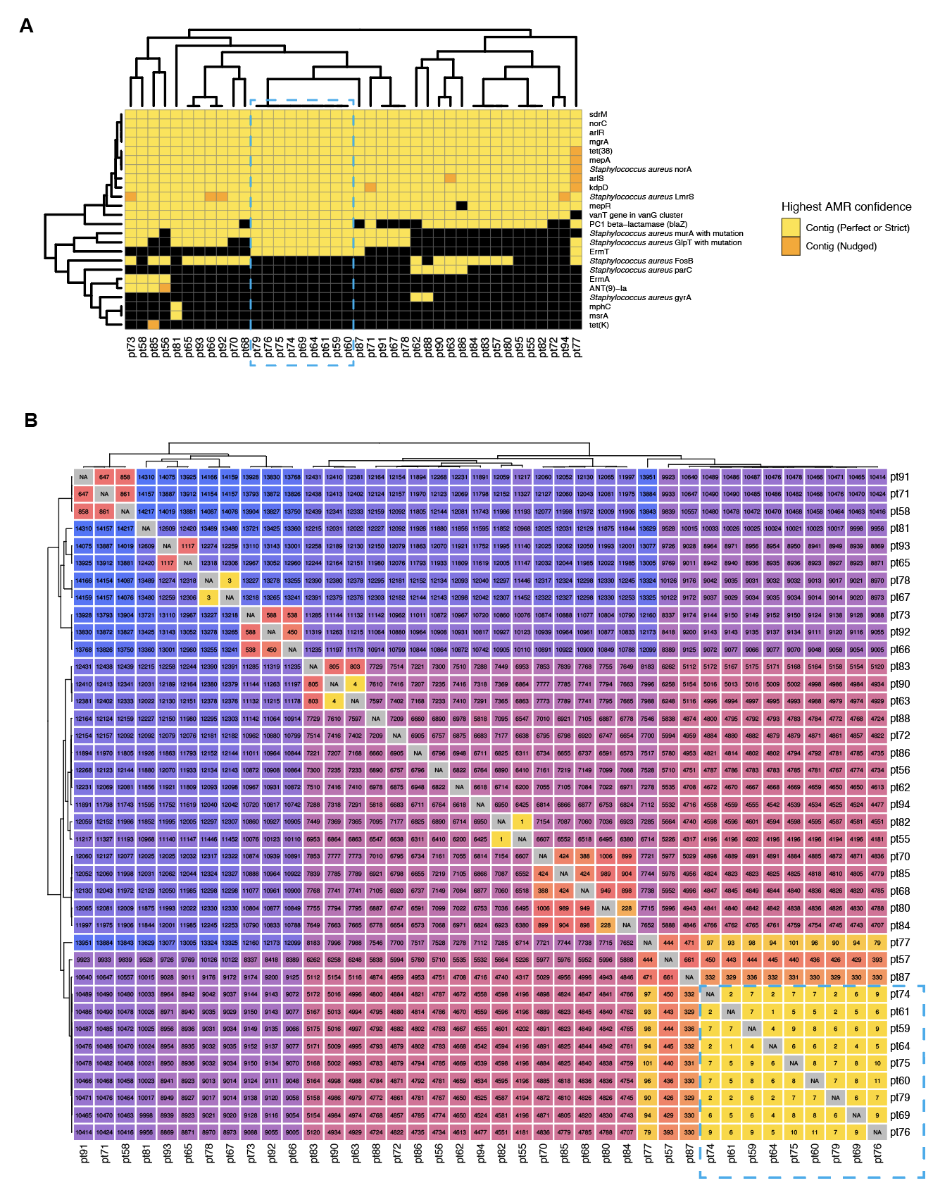
AMR profiles for MSSA isolates from patients (WGS)

Slide 40
AMR profiles for MSSA isolates from patients (WGS)
Identical AMR profiles
Downstream genome phylogenetic analysis revealed 11 SNPs between the 9 isolates

Slide 41
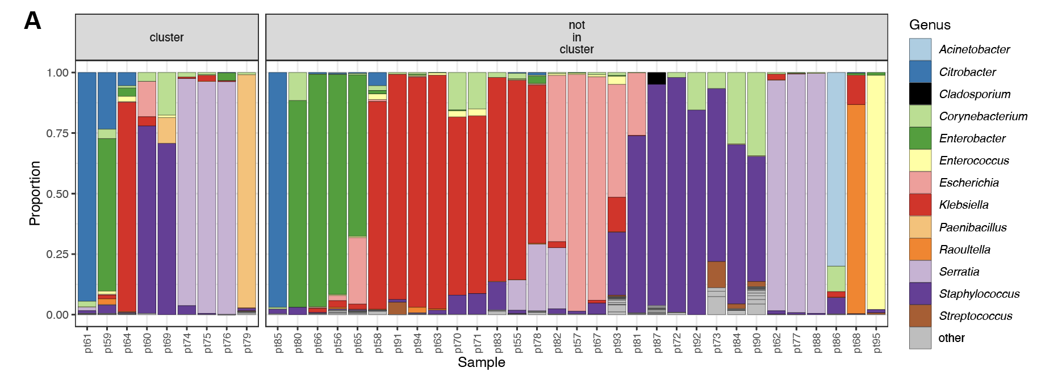
Bacterial species identified through mNGS

Slide 42
Bacterial species identified through mNGS
Other species identified, including pathogens
Unique profiles for samples from patients within MSSA cluster

Slide 43
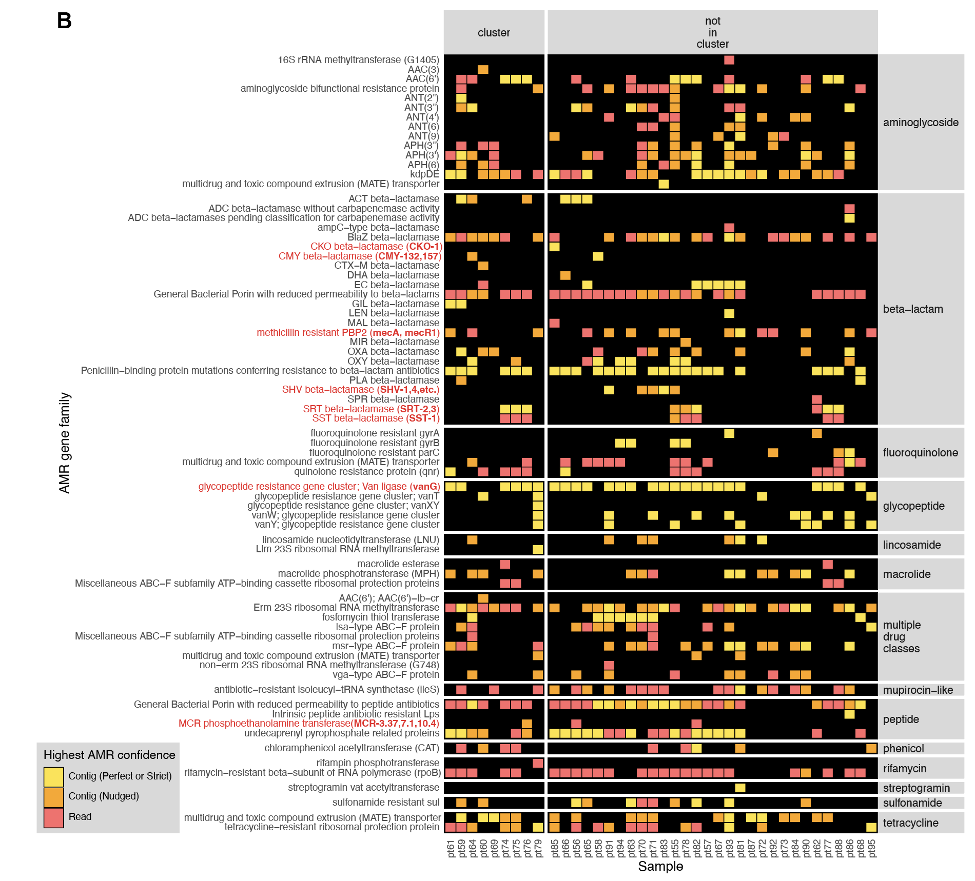
AMR profiles for mNGS samples

Slide 44
AMR profiles for mNGS samples
Diverse AMR gene detection in NICU patients

Slide 45
Example 3: Pathogen dynamics within pneumonia patient (Unpublished)
Case: Patient intubated for severe Human orthopneumovirus (HRSV) pneumonia who subsequently developed ventilator-associated Pseudomonas aeruginosa infection.
Approach: mNGS (RNA) of tracheal aspirate samples collected over a two-week period.
Notes:
Study cohort: Patients 31 d to 18 yrs of age who were expected to require mechanical ventillation via endotracheal tube for at least 72 h.

Slide 46
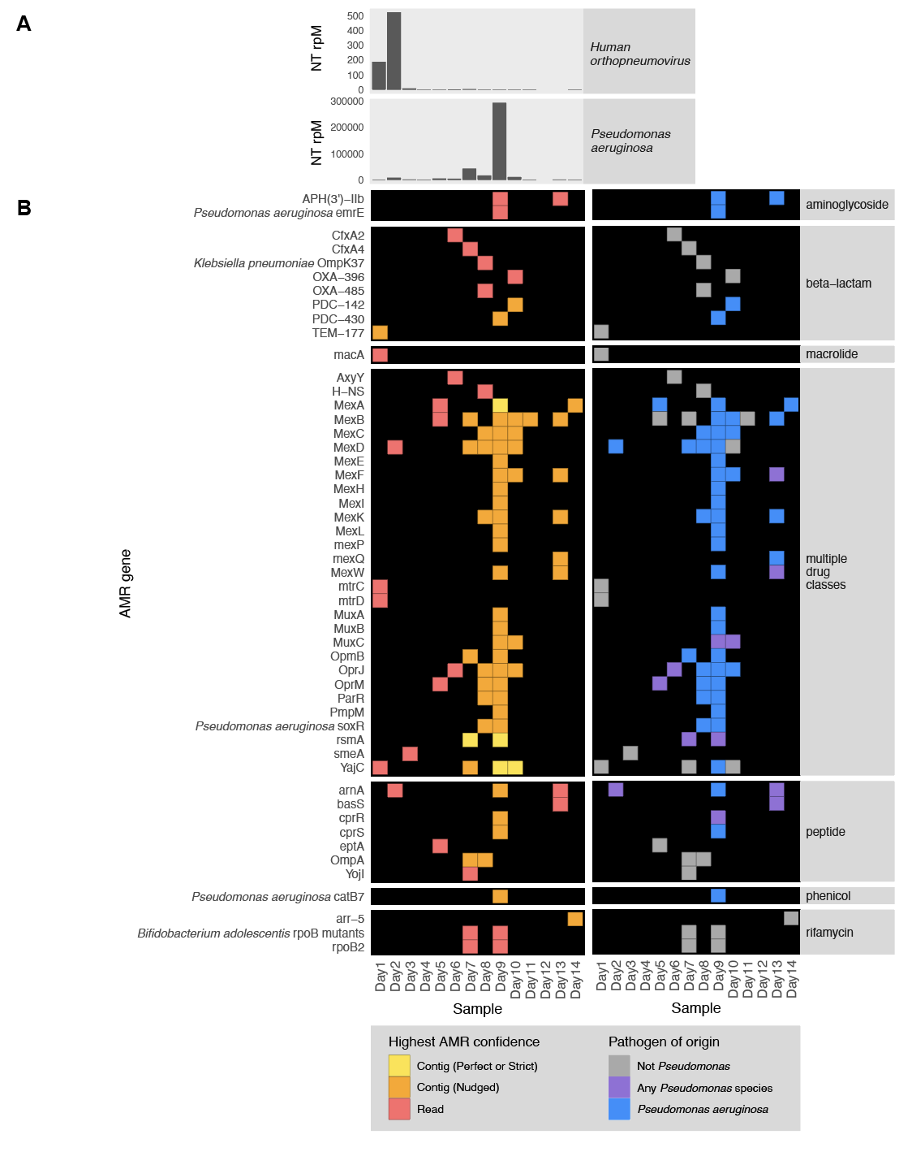
Read mapping results for Human orthopneumovirus and Pseudomonas aeruginosa
mNGS data reflected initial viral abundance and eventual clearance followed by an increase in P. aeruginosa abundance

Slide 47
AMR Results

Slide 48
AMR Results
P. aeruginosa-associated AMR genes tracked the relative abundance of this pathogen

Slide 49
Example 4: AMR gene detection in wastewater (data from Fuhrmeister et al 2021)
Wastewater surveillance study comparing Boston, USA to Vellore, India.
Approach: mNGS (DNA) of surface water, municipal wastewater, and hospital wastewater.

Slide 50
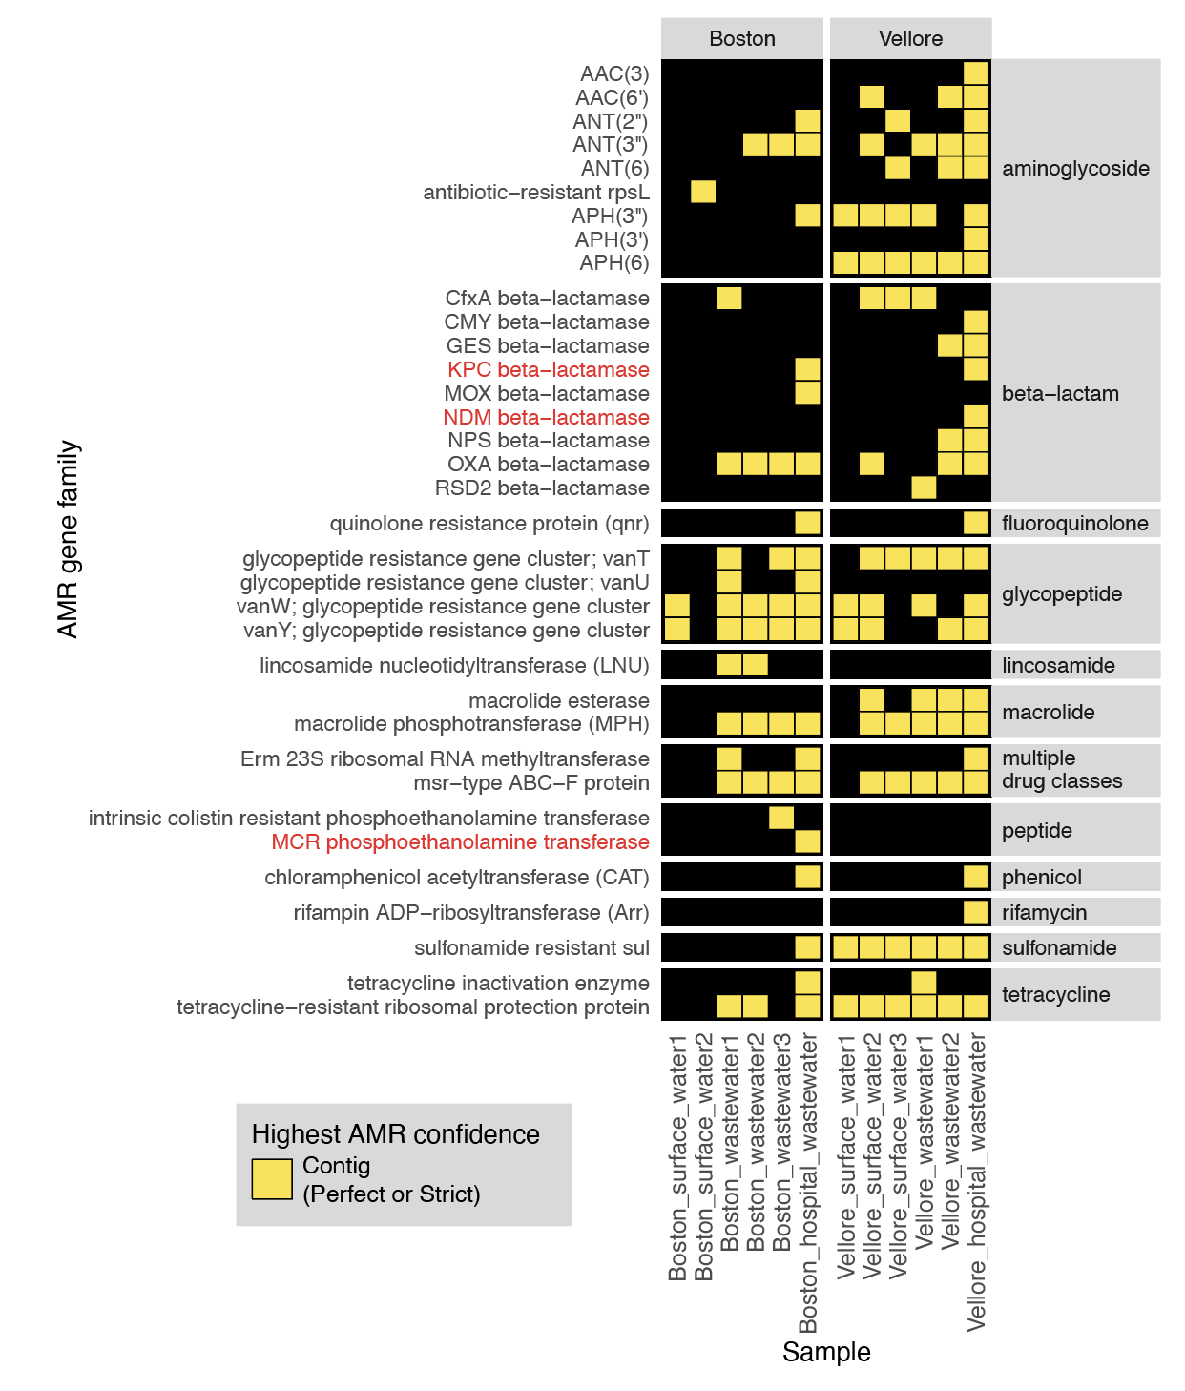
S - Surface water
W - Municipal wastewater
HW - Hospital wastewater
S1
S2
W1
W2
W3
HW
S1
S2
W1
W2
W3
HW

Slide 51
S - Surface water
W - Municipal wastewater
HW - Hospital wastewater
Diverse AMR genes detected in wastewater.
Hospital wastewater contains AMR genes of public health concern (infections with drug-resistant pathogens may be more prevalent in hospitals compared to the community)
S1
S2
W1
W2
W3
HW
S1
S2
W1
W2
W3
HW

Slide 52
Reference Guides
CZ ID AMR Resources
  Guides for how to upload and download AMR gene data, how to interpret and customize the AMR Sample Report, and general information about the AMR pipeline
Video: AMR Detection and Analysis Using CARD & RGI
  Presentation by Andrew McArthur (CARD/RGI Principal Investigator) providing background information and details about CARD and RGI workflow
Preprint describing AMR pipeline
  Simultaneous detection of pathogens and antimicrobial resistance genes with the open source, cloud-based, CZ ID pipeline

